Slide 1


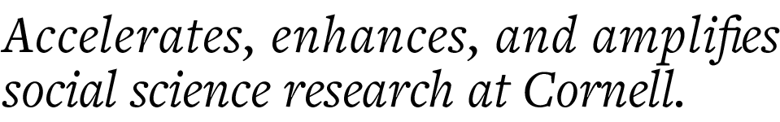
Cleaning and Analyzing Survey data using SPSS CCSS Workshop

Slide 2
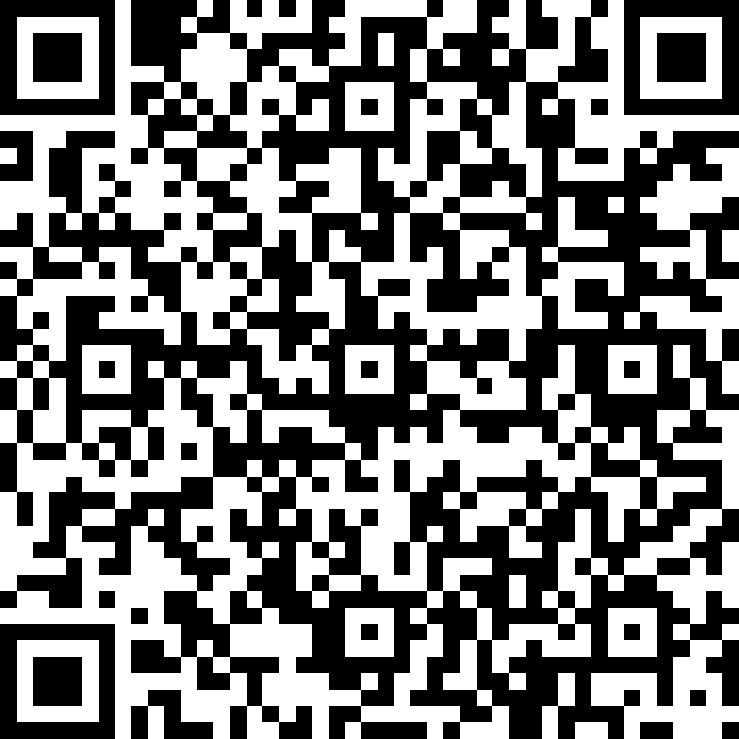
Attendance

Slide 3
Data Cleaning Techniques
Remove Missing Data
Drop Duplicates
Change Data type
Editing data
Drop Unwanted Data

Slide 4
Exercise Data Cleaning
*open sample dataset ‘Employee Data’ with following code.
GET
FILE='Employee Data.sav’.
DATASET NAME DataSet3 WINDOW=FRONT.
Remove rows that have 'missing' for previous experience(prevexp).
Create new dataset that consists of female managers and all minorities.

Slide 5
Exercise Summarizing Data
*open sample dataset ‘Employee Data’ with following code.
GET
FILE='Employee Data.sav’.
DATASET NAME DataSet3 WINDOW=FRONT.
Create new variable. Difference in starting and current salary.
If person is manager, increase wage by 5%
How many females in dataset?
Show distribution of salary using histogram.
Show frequency counts of 'educ' variable using barplot.
Compare difference in starting and current salary between males and females.

Slide 6
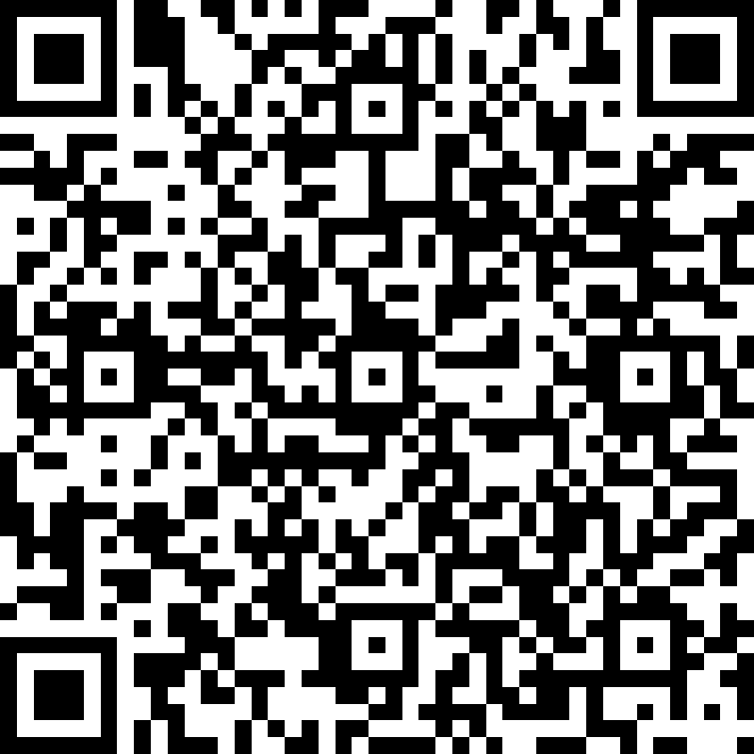
Evaluation

Slide 7
Thank you!
Contact us at CCSS-ResearchSupport@cornell.edu

